Slide 1
Software Product Engineering
Dr Daniel Schien and Dr Simon Lock

Slide 2
Key learning outcome
Work as part of an integrated development team
To build a real-world software system
Of significant size and complexity
For a real client organisation with real business needs:
Public sector organisations
Small and Large Businesses
Academics/ Departments
Charities & Social Enterprise

Slide 3
What this unit is NOT about
This is NOT just another programming unit
(Where you get a text description and just need to “code it up”)
It’s not going to be neat and tidy
It’s not going to be straight-forward
No lone maverick hackers heroically conjuring up mysterious code
This is managed and repeatable engineering of complex systems

Slide 4
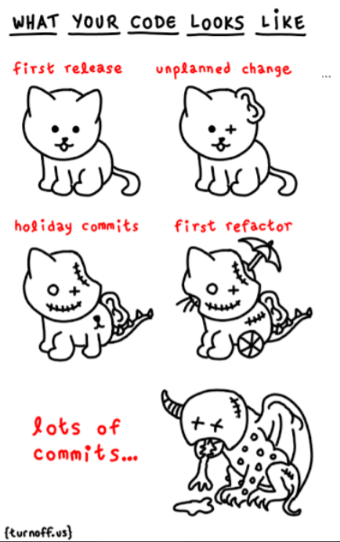
Your code currently be like…
“Managed and repeatable engineering of complex systems ?”

Slide 5
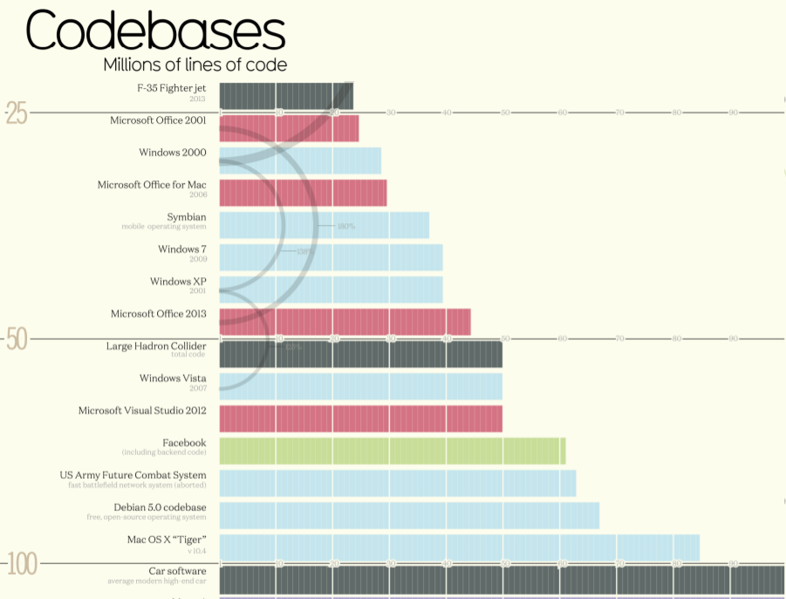

Slide 6
Essential Skills
Planning
Requirements analysis
Object-Oriented Design
Testing
System Integration
Releases & Deployment
Working as an integrated team
Cultivating client relationship
Evaluation & Feedback

Slide 7
Organisational Structure
Think of us as CEOs of a large development company
We are managing over 30 projects
We’ve drafted in mentors as “middle management”
Not technical support, but for monitoring and guidance
You will meet with them every 2 weeks (or so)
They will push out information to teams
Engage you in discussion
Gather feedback to pass back to Dan and Simon

Slide 8
Choosing Projects
There are various different approaches to forming teams
We’ve found the best way is to let students cluster around projects
In the practical session (next) we’ll release the project descriptions
Using our custom-built SPE content management system !!!
You may browse them and indicate your preferences

Slide 9
Forming Teams
In true spirt of Computer Science…
We’ll be using an algorithm to determine best fit
Pareto optimality - for the greater good !
No guaranteed allocation (soz !)

Slide 10
Implementation Technologies
We need consistency across the cohort if we hope to provide support
You are free to choose libraries / frameworks as appropriate
But Java must be your main implementation language:
Android mobile Apps
Java Server-side application framework (Spring Boot !)
Naturally, for web UIs you will have to use HTML/JS/CSS
Discuss with us if any of this is impractical for your client/domain

Slide 11
Development Support Tools
GIT or Subversion repositories for code / document sharing
Your favourite editor (might make sense to agree on one for team)
We recommend Maven as a build tool
Open Project for project management support (more next lecture !)
You may like to explore other communication and collaboration tools

Slide 12
Assessed Elements
Requirements and Design materials
The nature and quality of your development process
Meeting release deadlines and milestones
Team dynamics and relationship with client
The quality and extent of your finished product
"Viva" style presentation and discussion

Slide 13
Milestones
Choose your project preferences: 3rd October (by 13:00)
Teams finally allocated: Ready for 5th October !
First meeting with client: Week of 8th October (Most arranged on 10th)
Initial Requirements & Design documents: 16th November (13:00)
Deploy “Minimum Viable Product” release: 12th December (13:00)
Deploy “Beta Version” release: 13th February (13:00)
Deploy “Final Version” release: 17th April (13:00)
Submit full portfolio: 17th April (13:00)
Viva Presentation & Discussion: From 29th April

Slide 14
Team Effort
This is a team effort - you must work together
Your group mark will be determined by the output of the entire team
Your individual grade will determined by your contribution to the group
An individual cannot out-perform the team envelop and get a better grade
But they can under-perform and get a worse one !
Your individual grade will be based on your engagement with the project
(as assessed by a number of metrics - to be explained in the next lecture)

Slide 15
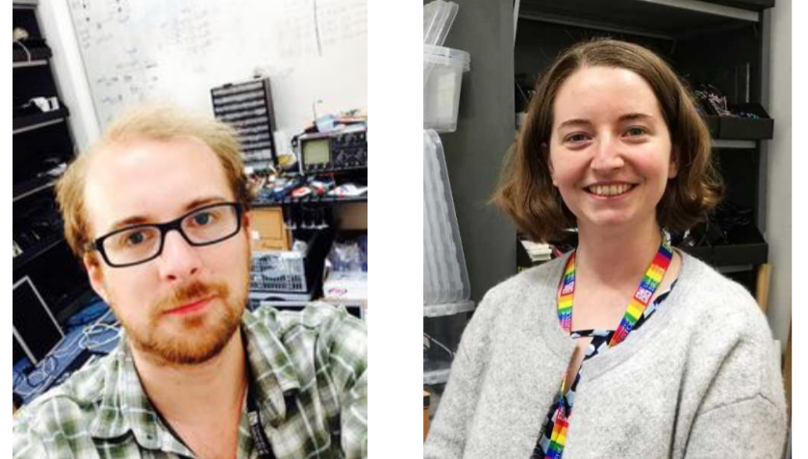
Support from Rich and Beth

Slide 16
Syllabus
}
Week 01: Introduction
Week 02: Software Process
Week 03: Integration, Verification & Validation
Week 04: Requirements Engineering
Week 05: Object Oriented Design
Week 06: Java Server Implementation
Week 07: User Interface Design
Week 08: CS Explore
Week 09: Datafeeds and Databases
Week 10: Web Dashboard Elements
Week 11: Evaluation and Feedback
Week 12: Progress and recap
Process Knowledge
}
Technical Development Skills

Slide 17
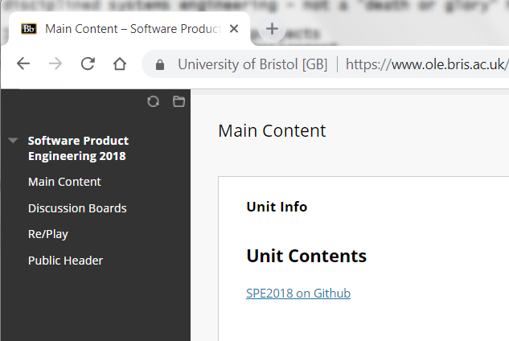

Slide 18
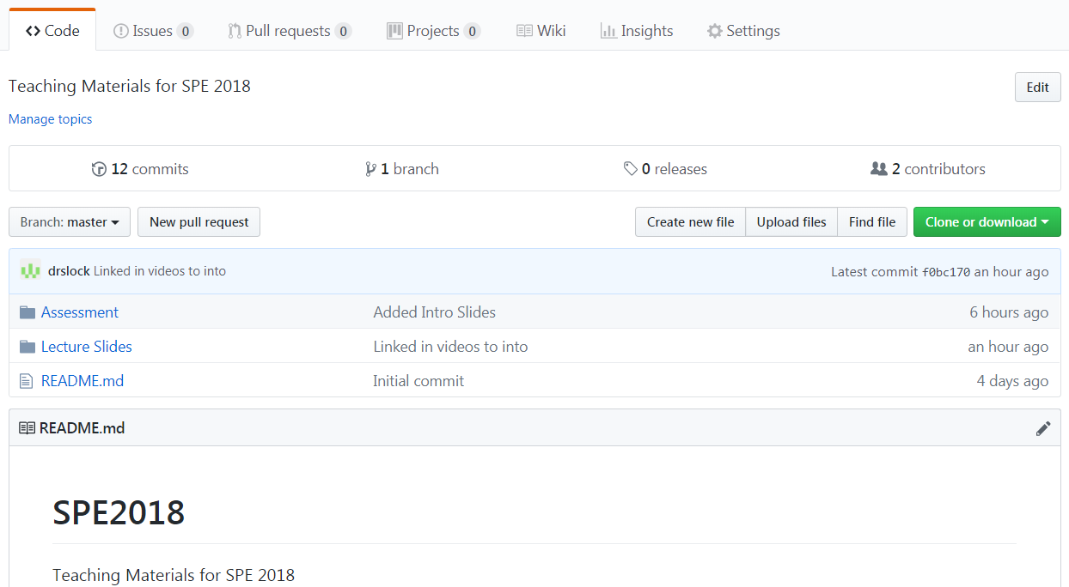

Slide 19
Timetable
2 Lectures per week
Weekly practical session exercises
Meetings with mentors
Meetings with clients
Co-located working as a team
"Reserved" Wednesday mornings

Slide 20
Questions ?

Slide 21
Let’s see some examples…

Slide 22


Slide 23
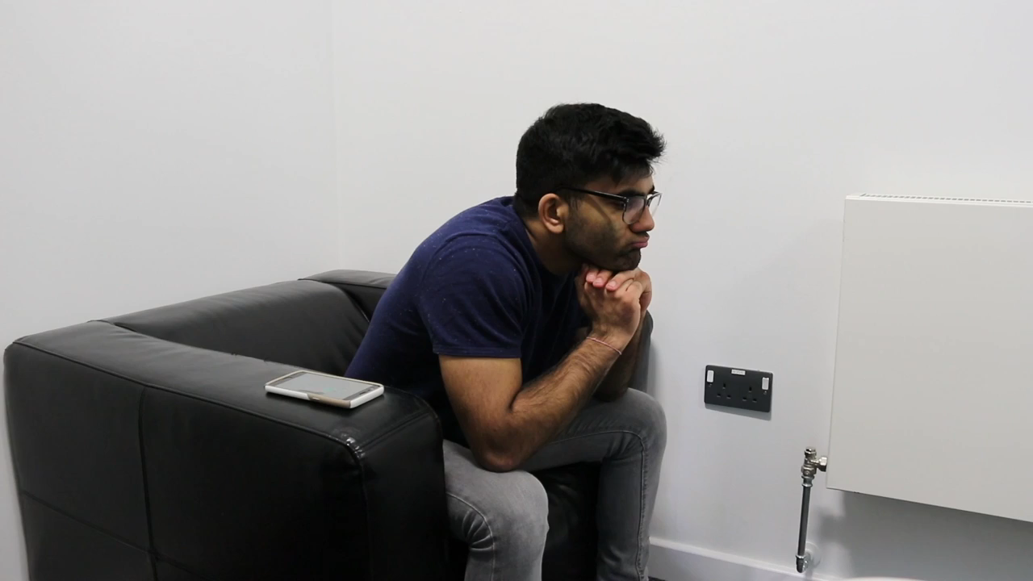

Slide 24
